Slide 1
Mark My Attendance – A.M.
Project Workshop -Samraddhi Gupta(B313) (A) -Kshitij Shah(D062) (C) -Nishit Mehta(B323) (A)

Slide 2
What is Mark my Attendance?
Mark my Attendance is an automated system/software designed to assist students ,faculties and the entire college with maintaining of attendance.
The current system of managing and marking the attendance has many problems which “Mark My Attendance” aims to solve permanently.
“Mark My Attendance” is a unique idea with a lot of room for expansion and development.

Slide 3
Why is it needed?
Problems with the Existing system :
Inefficient
Obsolete
Requires labour
Tedious

Slide 4
Who is it made for?
The three major objects are :
Faculty
Student
Admin (CC/HOD/Dean/Director)
All these modules require authentication which makes the system more efficient.

Slide 5
Technologies
Front-End
HTML
CSS
Bootstrap
Client-Side
JavaScript
Server-Side (Back-End)
PHP
MySQL (Database)

Slide 6
Available Solutions
No application exists in the market where the attendance manager is taking input from the Staff and then displaying current status to the students.
Also, graphs and charts used are easier to track the process either subject wise or as a whole, which is not a part of any existing system.
Applications exists wherein the students manually manage their attendance so as to know the current status.
Attendance Manager Android App, is one such application which allows managing by students.

Slide 7
Gantt Chart
Research 14-01
System Feasibility
End-January
Technology
1st week FEB
Deployment
4th Feb
Additional Features
TD – 10th April
BETA v1.1
TD – 18th March
Gathering of Database
TD – 10th March
BETA v1.0
26-02
Final Touch up 20th April

Slide 8
Current State of Project (BETA v1.0)

Slide 9
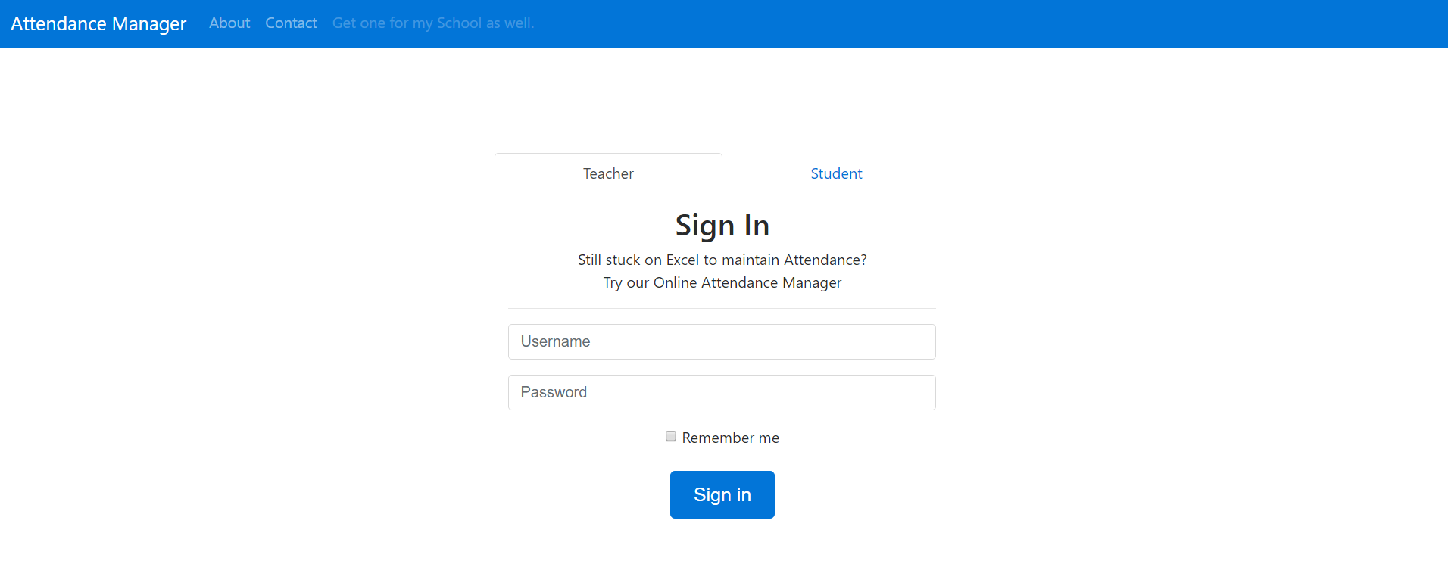

Slide 10
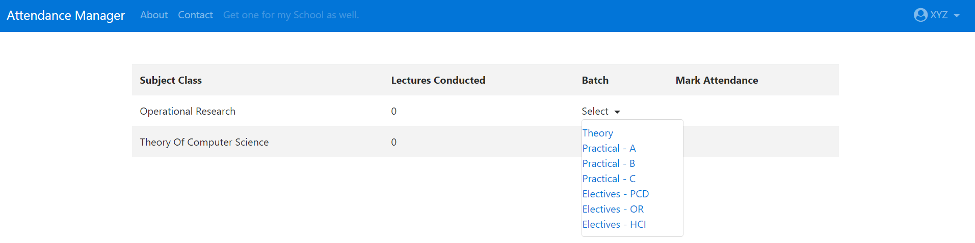

Slide 11
Future Advancements
E-Mail Notification when Attendance drops below 80%.
Mentees Attendance Report.
Detailed report at the end of semester with dates when the student remained absent.

Slide 12
DEMO

Slide 13
Conclusion

Slide 14
Thank You

